Slide 1
1
The
Correlation Technology Advantage
Using Correlation Technology to Gain Competitive Edge
For Business Inquiries: Contact: Carl Wimmer carl@makesence.us Mobile: (702) 767-7001
For Technical Inquiries:
Contact: Mark Bobick m.bobick@correlationconcepts.com Mobile: (702) 882-5664
COPYRIGHT 2O1O MAKE SENCE FLORIDA, INC. ALL RIGHTS RESERVED DISTRIBUTION WITHOUT WRITTEN PERMISSION OF MAKE SENCE FLORIDA, INC IS PROHIBITED

Slide 2
Correlation Technology
2
Whatever your industry or enterprise, whatever products or services delivered by your company to clients, customers and consumers…
If your enterprise is looking for an opportunity to integrate a unique, superior and fully customizable technology…
If your enterprise needs to create or strengthen your company’s distinctive capabilities in order to gain competitive edge…
You should know that a breakthrough technology called Correlation Technology can offer a powerful, completely new and unique solution to bring your enterprise to the forefront of your industry and deliver a unique value proposition to your customers.
Correlation Technology-based solutions are being independently developed for use in many vertical market sectors right now. All these solutions will be built on the Correlation Technology Platform, which will power enterprise applications in specific vertical market sectors -- solving fundamental business issues in a way that has never been done before.

Slide 3
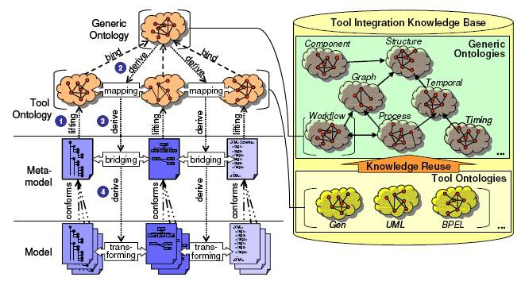
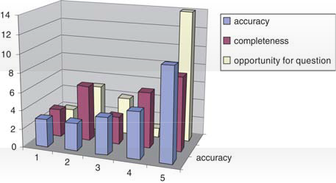
3
To solve critical problems, enterprises have been obliged to adopt solutions that are based on these three techniques. Such solutions are typically very expensive, very complex and often fail to deliver.
Subjective Statistical Methods
Massive Semantic Infrastructure
Brute Force Computation
In contrast, Correlation Technology can power solutions that are a more natural fit for these critical problems. Correlation Technology is revolutionizing the way data is handled to provide a distinct advantage to enterprises around the world.
CORRELATION TECHNOLOGY

Slide 4
Industry Solutions vs Correlation Technology
4
CASE STUDY: Market Research
Massive Semantic Infrastructure
In market research, data is gathered, decomposed and analyzed from respondent focus groups, interviews and surveys. Formal language parsing is typically used to elicit meaning from the data, but manual processes constantly introduce bias and error into many current systems.
Huge, complex databases and expensive hardware are often required for the most simple of computations. Fully automated analysis can not be performed by any system currently in use. Yet, even with sophisticated semantic components in place, market researchers struggle to deliver actionable intelligence and meaningful data to clients.
The problem lies in such systems’ formal and inflexible model of human expression. Despite tagging, threading, entity recognition, ontologies, and concept repositories, these formal structures often do not accurately capture the true intent of respondents. Human expression is highly adaptive, and chaotic. Humans create and utilize idiomatic, vernacular, and colloquial terms and uses for terms with astounding ease. Writers of even the shortest communication incorporate cultural memes that no dictionary, no ontology, no concept map, no semantic infrastructure component could keep current or sort out.
The Correlation Technology Solution
The Correlation Technology market research solution automatically decomposes all gathered data into natural Knowledge Fragments - for analysis without the manual processes which introduce human bias and error.
True intent of respondents is discovered by connecting Knowledge Fragments into “correlations”. True respondent sentiment can be discovered even on topics outside the framework of focus group discussions, interviews or surveys.
More precise and meaningful intelligence
– actionable intelligence - is delivered to clients.

Slide 5
Industry Solutions vs Correlation Technology
5
CASE STUDY: Money Laundering Detection
Subjective Statistical Methods
In the United States and the EU, law enforcement and regulatory authorities require all financial institutions to detect, flag and report all “suspect” accounts, transactions, individuals and institutions.
The United States requires reporting of even the most casual indicator of violation. In the UK, a more relaxed standard raises the threshold for flagging and reporting. The most sophisticated money laundering detection software on the continent uses Bayesian techniques – essentially a subjective statistical method – to compare monitored activity against a reference model.
Yet, despite the widely acknowledged intelligence, experience and expertise of the people behind this software, and despite the relaxed standard for reporting, the false-positive rate for this software is 50% or higher.
The problem is simply that even the most intelligent, well informed, and sophisticated people can never genuinely comprehend the web of relations in systems as large and volatile as the financial system
– and can never therefore more fully and accurately model such a system by assignment of conditional probabilities.
The Correlation Technology Solution
The Correlation Technology money laundering detection solution constructs a dynamic “control” model of the web of relations connecting institutions, accounts, persons, and transactions. This model incorporates data from sources outside the event categories, numerical values, and limited set of constraints typically used to build Bayesian networks and series in this realm.
Tightly coupled to the underlying conditional probability architecture, a Correlation Technology solution can flag and confirm as anomalies specific events also flagged in the purely Bayesian network – and rapidly identify the full set of relations between participating persons and institutions.
With concurrence of the two independent systems, false-positives can be reduced, and all parties subject to these necessary monitoring functions can realize substantial reduction in time and cost.

Slide 6
Industry Solutions vs Correlation Technology
6
CASE STUDY: Recruitment
Brute Force Computation
The Correlation Technology Solution
The Correlation Technology recruitment solution works by discovering the set of relations connecting each candidate to a position, a company, and a workplace.
Utilizing, on one side, the candidate resume, and all publicly-available resources about the candidate and, on the other side, the job description, company information, and workplace details, relevant data is decomposed into small pieces of meaningful information called Knowledge Fragments. From the Knowledge Fragments, “correlations” affirmatively linking chains of Knowledge Fragments are constructed. By discovering and ranking the most – and most positive - relations from candidate to position, company and workplace, the Correlation Technology solution can determine the best available candidate for the position, dramatically increasing employee retention success.
The recruitment industry attempts to place job applicants into job positions, and vice versa, by utilizing a lexical brute force method called keyword search.
To identify suitable candidates within a vast ocean of applicant resumes, most current industry software utilizes keyword search terms entered by unskilled recruiters to match candidate attributes to terms in job descriptions stored in databases. For human resource departments inundated with large volumes of indistinguishable resumes, this inflexible brute force method too often results in ideal candidates being overlooked and candidates being hired that have little chance to fit into a company, position, or a work environment.
Keyword search has proved ineffective in reducing the number of resumes requiring manual review, and has not delivered the efficiencies expected of computer- driven technology solutions.

Slide 7
The Correlation Technology Advantage
7
For our partners and licensees, the basis of competitive advantage is the development of distinctive capabilities.
Distinctive Capabilities The Correlation Technology Edge
•Intellectual property rights •
•Exclusive licenses
With an exclusive license to the fully-patented Correlation Technology Platform our partners will create their own intellectual property and own full rights to the software solutions they create for their vertical market sector implementation.
•Partnerships
This will make enterprise technologies powered by Correlation Technology unique and difficult to replicate. There is no technology that can utilize data like Correlation Technology.

Slide 8
The Correlation Technology Advantage
8
Distinctive Capabilities
•Differentiation
•Business Processes
The Correlation Technology Edge
Correlation Technology can power your applications to provide your customers with unique products or services.
Correlation Technology can help enterprises create non-standardized products, services and processes that can be modified to fit organization structure, clients, customers and consumers with unique needs.
Gain competitive edge by integrating Correlation Technology to add value and streamline your business processes.
Improve the acquisition and utilization of actionable intelligence and enhance data use to protect market share, increase barriers to entry and grow consumer base.
Each Correlation Technology-driven solution delivers a unique value proposition to customers.

Slide 9
9
The Correlation Technology Advantage
Resource-based View
Knowledge is the most important value-creating asset an enterprise can utilize to gain competitive advantage. Correlation Technology provides enterprises with a revolutionary new way to utilize data, manage information, and develop richer, more in-depth insights into organizations, clients, customers, consumers and markets.
Economies of Scale
Since Correlation Technology Platform is a true software platform and not an end-user application, it can power a substantial number of different applications across many vertical market sectors, so long as the application can be technically validated by our R&D department.
Tacit Knowledge
Correlation Technology can allow expert and non-expert employees to operate with maximum efficiency by automating many manual processes used in current industry solutions. This minimizes the amount of tacit knowledge that must be handed down from employee to employee and sharply decreases the learning curve of new employees. Training costs are reduced and operational bottlenecks are eliminated.

Slide 10
Be A Market Leader
10
The main objective of every enterprise is to be the industry leader. This means adding value to your core competencies by being on the cutting edge of:
Developing new business models
Providing new products and services
Utilizing new technologies
Implementing innovative business processes
Delivering a unique value proposition to customers
Offering well-differentiated products or services
Enterprises that adopt Correlation Technology can provide superior products or services that are unique and difficult to replicate.
Correlation Technology-based solutions are sustainable and applicable to multiple situations, ensuring enterprises will continually be at the cutting edge of their industry.

Slide 11
11
A number of uses for Correlation Technology have already been identified in more than twenty different vertical market sectors.
If your enterprise can benefit from gaining a significant competitive edge by utilizing Correlation Technology,
CALL OR EMAIL
ASK FOR A LIVE WEBEX DEMONSTRATION
Our team of consultants, technicians and analysts will work with you to discover how Correlation Technology can be applied to enterprise systems to gain competitive advantage.
For Business Inquiries: Contact: Carl Wimmer carl@makesence.us Mobile: (702) 767-7001
For Technical Inquiries:
Contact: Mark Bobick m.bobick@correlationconcepts.com Mobile: (702) 882-5664

